Slide 1
Property Assessment Seminar
Lenox Township
Property Appeals Process
Understanding the assessment change notice and preparing for the March Board of Review. The Seminar will also include a question & answer session with Lenox Township Assessing Department.
Seminar Location
Lenox Township Hall
January 15th, 2013
7PM-9PM
Lenox Twp Hall

Slide 2
Property Appeals Process
March Board of Review
What is the March Board of Review? The March Board of Review is a body with members appointed in each municipality to review the assessment roll received from the Assessor to ascertain it is complete, accurate, uniform and valid. They then conduct public hearings in March to hear appeals from property owners.
Should I Appeal to the Board of Review?
Each year, prior to the March meetings of the local board of review, assessment change notices are mailed. These informational notices include State Equalized Value, Taxable Value, the percent of exemption as a Principal Residence or Qualified Agricultural Property, and whether or not an a Transfer of Ownership has occurred. If you believe the Assessed Value is more than half the value of your property, you may appeal the Assessed and /or Taxable Values at the March Board of Review. You can obtain information about the specific meeting dates and schedule an appearance with the Board of Review by contacting your local assessing office. The Board has no control over millage rates or property taxes. Other reasons to appeal to the Board of Review would include:
CLASSIFICATION: Indicates the use of your property. There are six classifications, Agricultural, Commercial, Developmental, Industrial, Residential and Timber Cutover.
STATUS: Certain properties are tax-exempt.
EQUITY: All properties within the jurisdiction are to be assessed at the same ratio; 50% of TCV.
HARDSHIP: Poverty stricken property owners can request tax relief from the Board of Review through a hardship. Household financial documentation will be required.
Am I Required to Attend the March Board of Review for a Commercial/Industrial Real Property?
No. As of 2007 Commercial and Industrial Real properties no longer have to petition to the March Board of Review. These appeals can be made directly to the Michigan Tax Tribunal on or before May 31st.
Am I Required to Attend the March Board of Review for Personal Property?
No. Personal Property can be appealed directly to the Michigan Tax Tribunal provided a Personal Property Statement has been filed before the commencement of the March Board of Review. If the statement has not been filed an appearance at the March Board of Review is required. Michigan law indicates that Personal Property Statements are due February 20th. The appeals to the Michigan Tax Tribunal must be made by May 31st .
Any property owner or their designated agent may file an appeal regarding the assessment of a property within the Board’s jurisdiction. By law, non-resident property owners can appeal by letter. The Township will allow letter appeals by residents as well. Most commonly the property owners appeal in person. You will need to schedule an appointment if you or your agent is to appeal in person. The Board of Review meetings are open to the public in compliance with the Open Meetings Act.

Slide 3
Definitions
Assessed Value (AV) – Generally the same as state equalized value unless an equalization factor other than 50% has been applied by either the county in which the property is located or the State. Your property’s assessment change notice will indicate your property’s state equalized and assessed values and the amounts those values have increased over the previous tax year’s state equalization and assessed values.
Entire Tribunal – The formal division of the Tribunal. Hearings are held in Lansing before a Tribunal Member.
Principal Residence Exemption (PRE) – Given to the property that is the primary residence of the property owner upon the filing of a principal residence exemption affidavit.
Small Claims – The informal division of the Tribunal. Hearings are held telephonically or in-person in the county where the property is located or an adjoining county but within 100 miles of the property.
State Equalized Value (SEV) – One-half ½) of your property’s true cash value.
State Equalized Value in Contention – The difference between what the petitioner and the respondent believe to be the property’s state equalized value for each tax year at issue.
Taxable Value (TV) – Is not the same as the property’s true cash value. It is the value used to calculate your property taxes. A property’s taxable value can only increase annually by the rate of inflation or 5%, whichever is less, unless there is an addition to the property (i.e. physical improvement or omitted property) or the property’s ownership transferred during a previous tax year. See MCL 211.34d. Your property’s assessment change notice will indicate your property’s taxable and the amount the taxable value has increased over the previous tax year’s taxable value. A property's taxable value can also decrease if there is a physical loss to the property. See MCL 211.34d.
Taxable Value Contention – The value that the petitioner believes it should have been for each tax year at issue.
Taxable Value in Contention – The difference between what the petitioner and the respondent believe to be the property’s taxable value for each tax year at issue.
True Cash Value – The fair market value or the usual selling price of property. For a more detailed definition see MCL 211.27.
Uncapping of the Taxable Value – When a transfer of property ownership occurred during a previous tax year, the taxable value of that property is uncapped and becomes the same as the state equalized value of the property.
…More Property Assessment Terminology:
http://www.michigan.gov/taxtrib

Slide 4
SEMINAR AGENDA
-Assessing Contacts
-Lenox Township 2013 Overview
  Proposal “A” Review & Assessing 101
  Sales Study
  Market Analysis
  Foreclosures
-Assessment Change Notice
-Consumer Price Index / Inflation Rate Multiplier
-Appealing Your Assessment
  Research
  Appeal Outcomes
-Information/Question and Answer

Slide 5
ASSESSING CONTACTS
Website: www.lenoxtwp.org
Phone: (586) 727-2085
Staff: Lisa Griffin, Assessor
lgriffin@lenoxtwp.org
Ses Cianferra, Appraiser
scianfera@lenoxtwp.org
Christine Marin, Assessing Clerk
cmarin@lenoxtwp.org

Slide 6
PROPOSAL “A”
On March 15, 1994, Michigan voters approved the constitutional amendment known as Proposal “A”. Prior to Proposal “A” property tax calculations were based on State Equalized Value (SEV). Proposal “A” established “Taxable Value” (TV) as the basis for the calculation of property taxes. Increases in Taxable Value (TV) are limited to the percent of change in the rate of inflation or 5%, whichever is less, as long as there were no losses or additions to the property. The limit on TV does not apply to a property in the year following a transfer of ownership (sale).

Slide 7
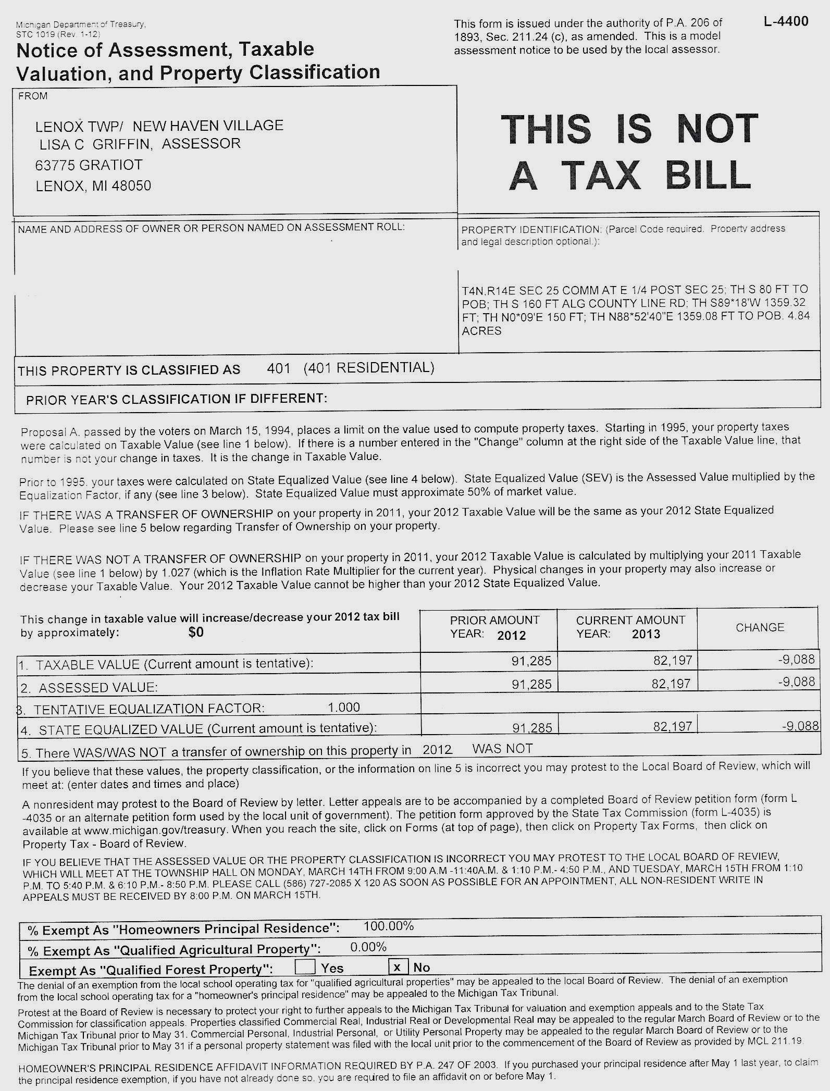
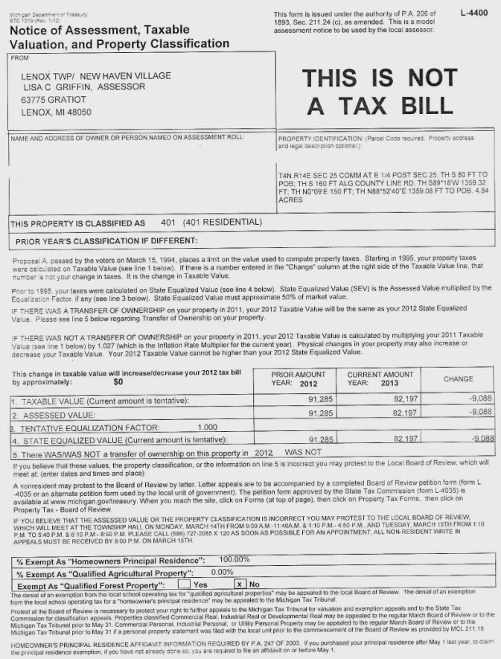
2013 ASSESSMENT CHANGE NOTICE

Slide 8
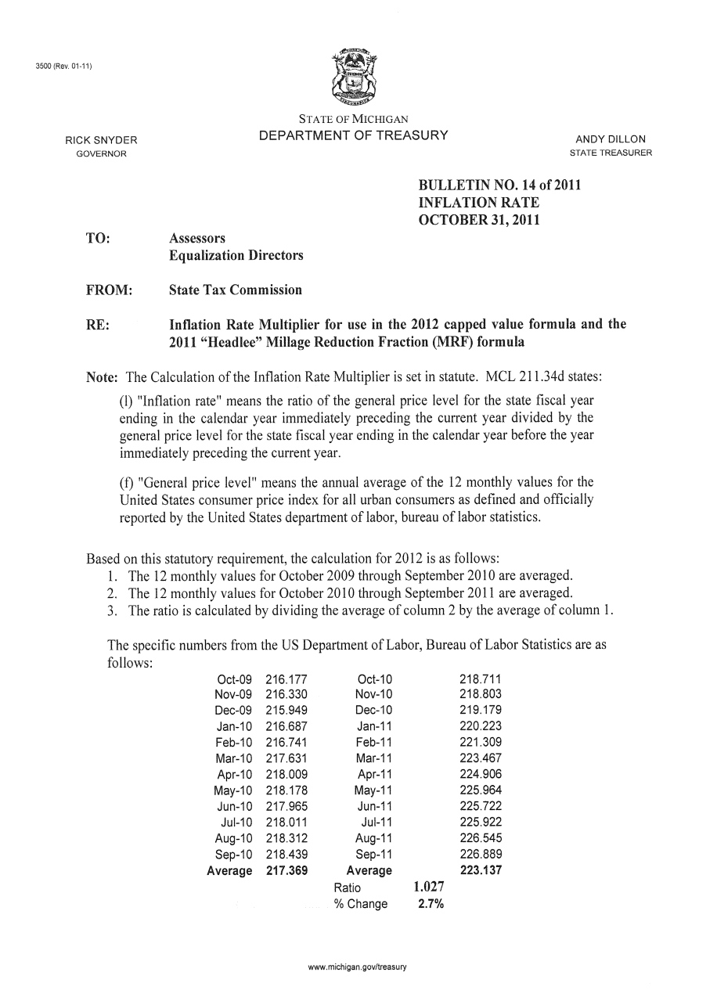
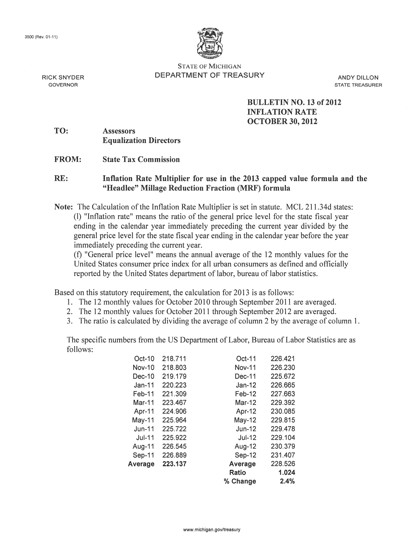
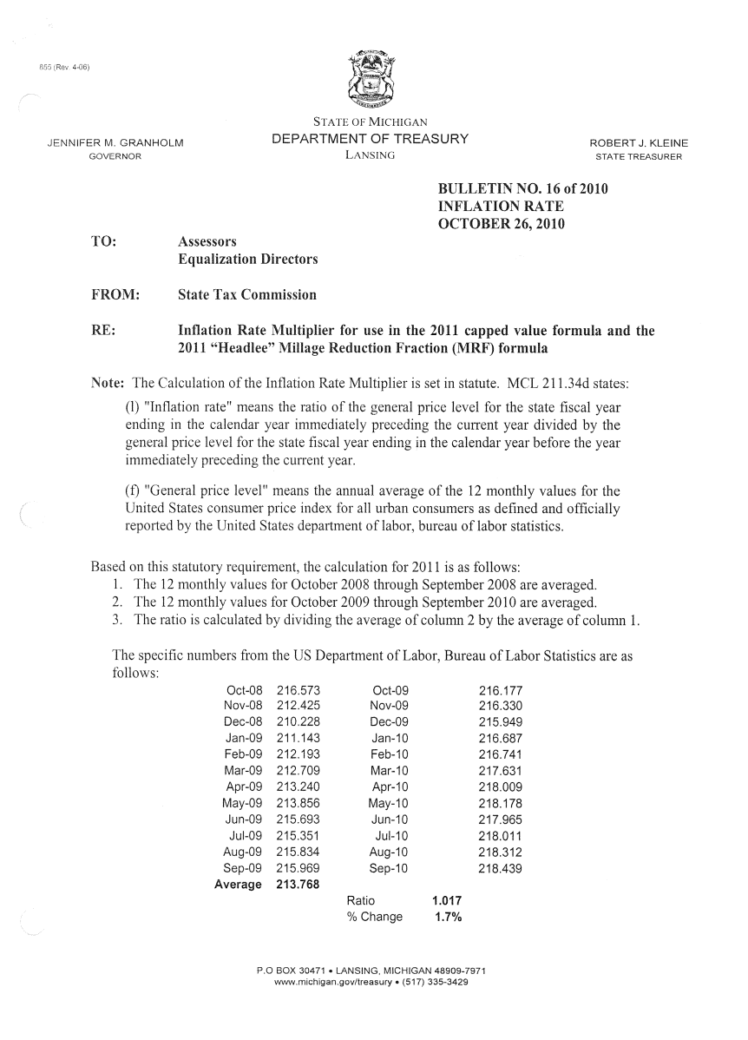
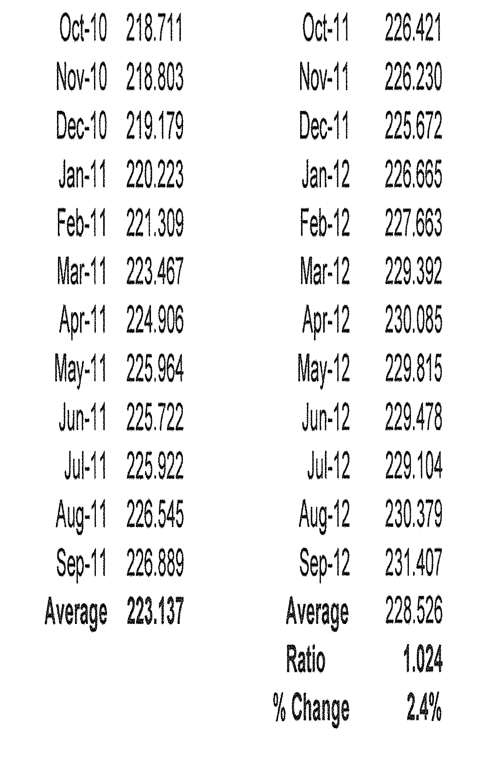
IRM – 2013 Inflation Rate Multiplier
State Tax Commission
BULLETIN NO. 13 OF 2012
INFLATION RATE
OCTOBER 30, 2012

Slide 9
IRM – Inflation Rate Multiplier
2.6%
2.8%
2.8%
2.7%
1.6%
1.9%
3.2%
3.2%
1.5%
2.3%
2.3%
3.3%
3.7%
2.3%
4.4%
-0.3%
1.7%
2.7%
2.4%
Taxable Value Calculations are derived by using
IRM/CPI percentages. This has been mandated since the introduction of proposal “A” in 1994. IRM/CPI is calculated by the US Department of Labor. http://www.bls.gov/cpi

Slide 10
THE GENERAL PROPERTY TAX ACT (EXCERPT)
Act 206 of 1893
211.27 “True cash value” defined; considerations in determining value; indicating exclusions from true cash value on assessment roll; subsection (2) applicable only to residential property; repairs considered normal maintenance; exclusions from real estate sales data; “present economic income” defined; applicability of subsection (4); “nonprofit cooperate housing corporation” defined; value of transferred property; “purchase price” defined; additional definitions; “standard too” defined.
Sec. 27.
(1) As used in this act, “true cash value” means the usual selling price at the place where the property to which the term is applied is at the time of assessment, being the price that could be obtained for the property at private sale, and not at auction sale except as otherwise provided in this section, or at forced sale. The usual selling price may include sales at public auction held by a nongovernmental agency or person if those sales have become a common method of acquisition in the jurisdiction for the class of property being valued. The usual selling price does not include sales at public action if the sale is part of a liquidation of the seller’s assets in a bankruptcy proceeding or if the seller is unable to use common marketing techniques to obtain the usual selling price for the property.

Slide 11
IRM and Proposal “A”
Increased SEV/TV Increase
Last year, your home valued at $200,000 (true cash value) had a $100,000 State Equalized Value (SEV), and a Taxable Value (TV) of $80,000.
A Study of sales in the neighborhood shows the true cash value of your property has increased to $220,000 for the current year.
Current Year:
Assessed Value (AV) is (1/2 of $220,000)……..$110,000
SEV (tentative) is………………………………….$110,000
Capped Value (CV) is ($80,000x1.024)*………..$ 81,920
Taxable Value, the lesser of SEV or CV, is……..$ 81,920
*1.024 (or 2.4%) is the Inflation Rate Multiplier for 2013

Slide 12
IRM and Proposal “A”
Decreased SEV/TV Increase
Last year, your home valued at $200,000 (true cash value) had a $100,000 State Equalized Value (SEV), and a Taxable Value (TV) of $80,000.
A Study of sales in the neighborhood shows the true cash value of your property has decreased to $180,000 for the current year.
Current Year:
Assessed Value (AV) is (1/2 of $180,000)……..$90,000
SEV (tentative) is………………………………….$90,000
Capped Value (CV) is ($80,000x1.024)*………..$81,920
Taxable Value, the lesser of SEV or CV, is……..$81,920
*1.024 (or 2.4%) is the Inflation Rate Multiplier for 2013

Slide 13
?
What are my options after receiving the Change of Assessment Notice?
Review Property Record Card
Contact the Assessor
Make an Appointment for MBOR

Slide 14
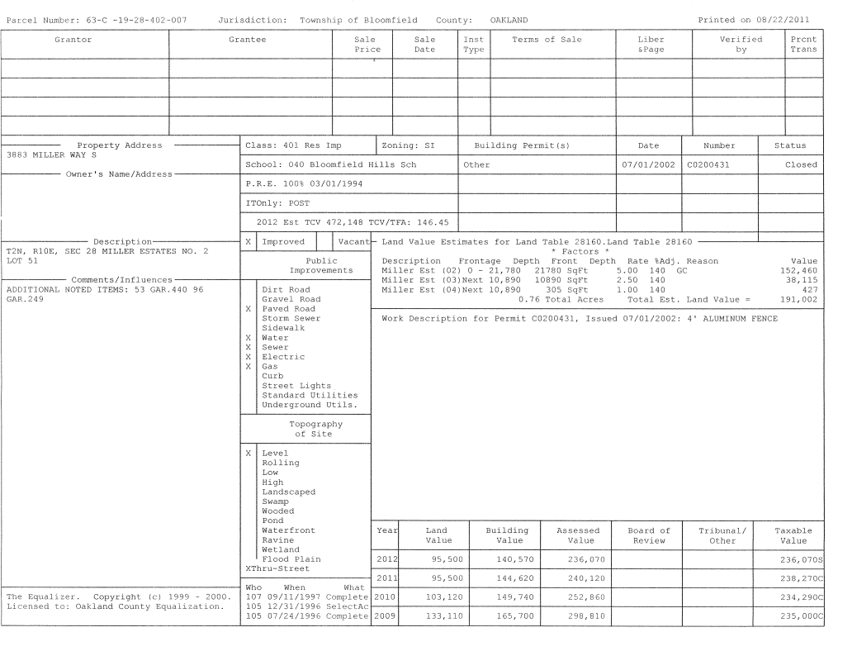
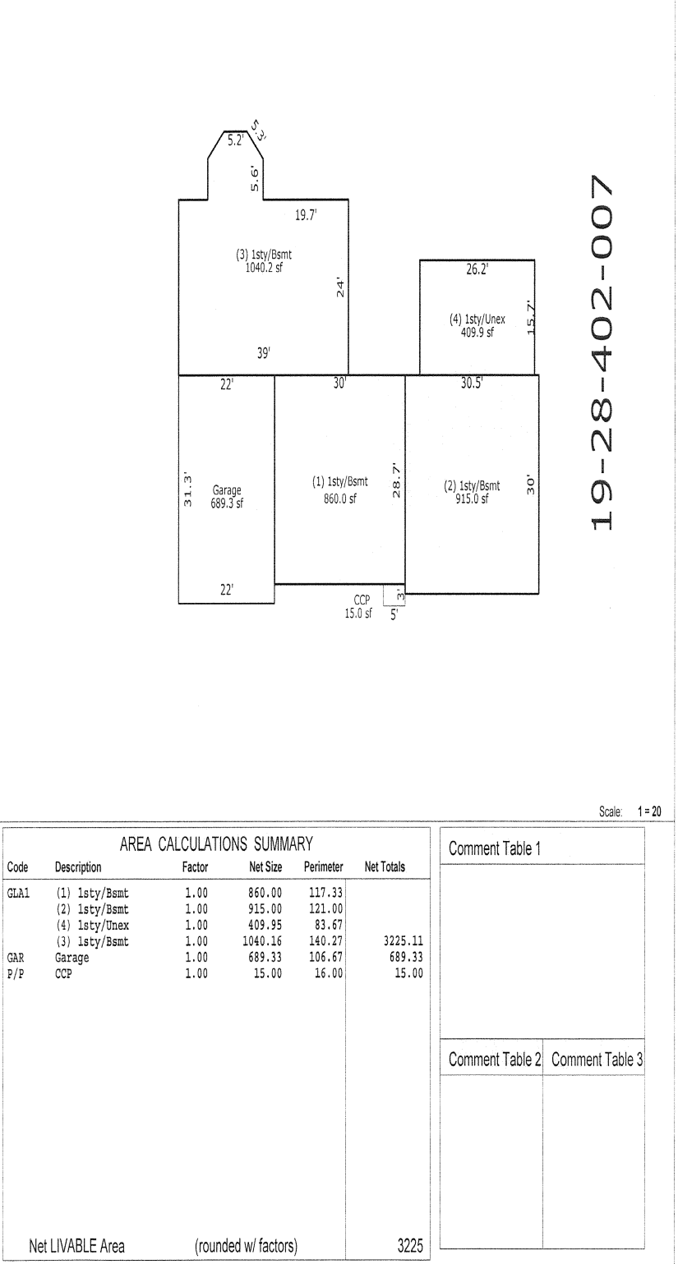
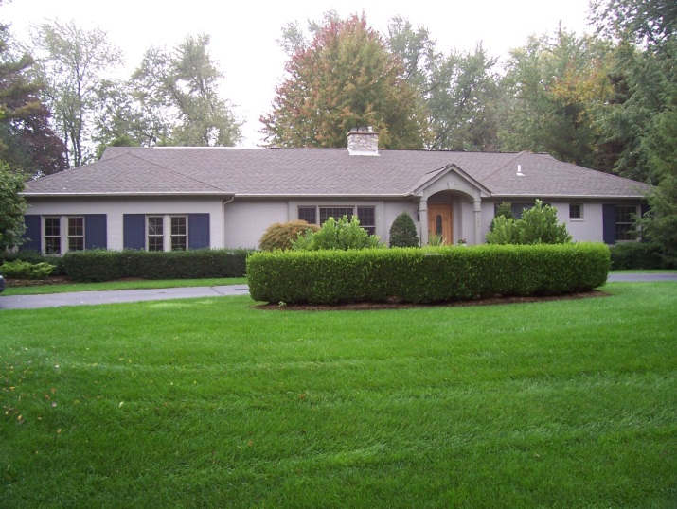
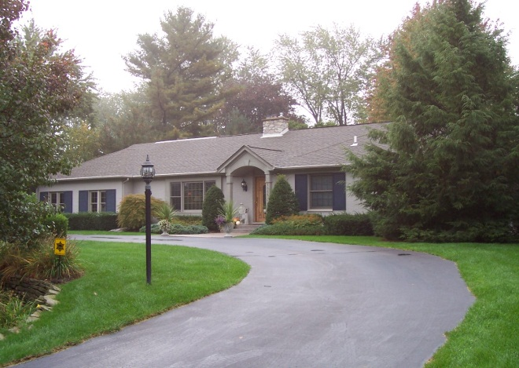
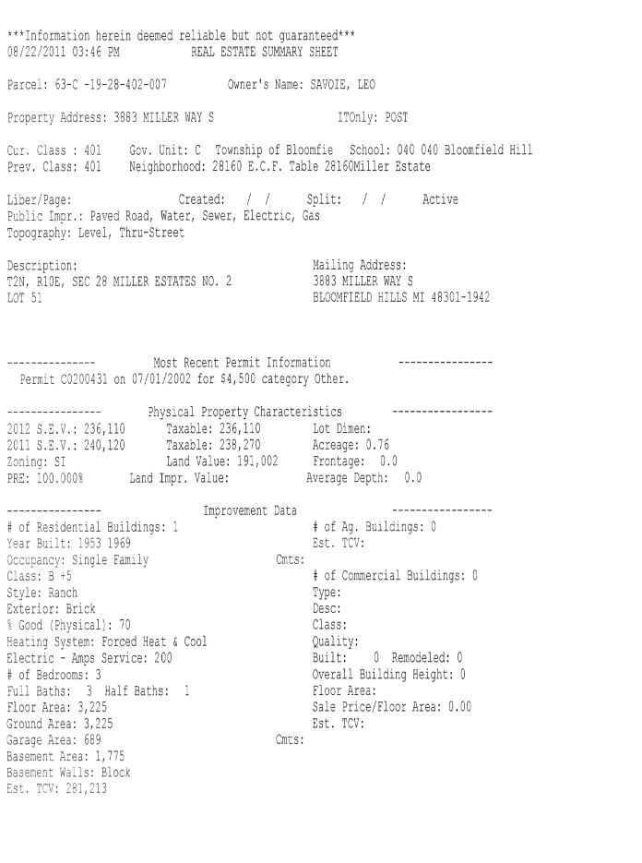
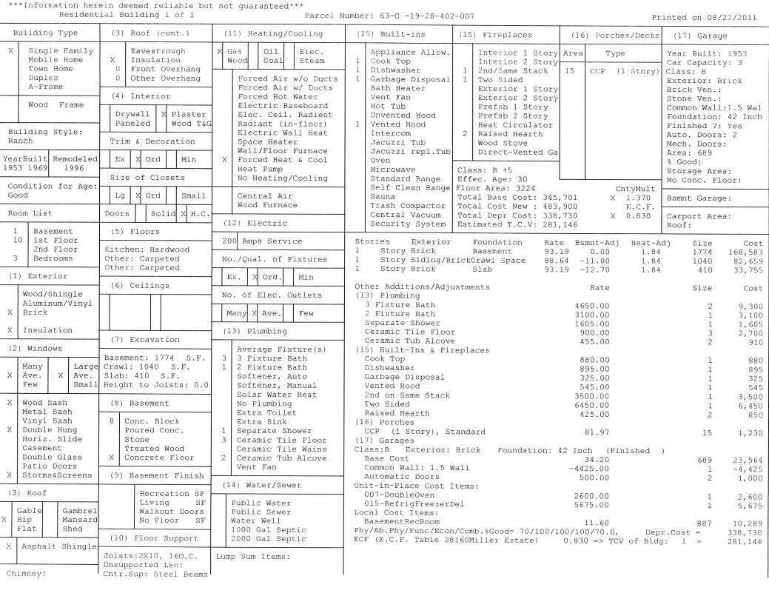
Residential Record Cards

Slide 15
Important Items to Review on the Property Record Card
Land Size
Square Footage of Building (exterior Measurements)
Class of Building (A,B,C,D)
Garage
Bathrooms
Basement Finish
Built-in Appliances
Year Built
Fireplaces
Out-Buildings, Pools, Patios, Etc.
This is just a sample of Facts to verify and review with your Assessor

Slide 16
How Assessments are Formulated
Step 1:
Cost Approach

Slide 17
How Assessments are Formulated
Look for Sales within this Timeframe.
Look for properties like your own (subject) neighborhood
Establishes 2013 Taxable Value for 2013 July and December levies.
Sales Study Timeframes are determined by the State Tax Commission
1 Year Study
10-1-2011 9-30-2012

Slide 18
Methods of Adjusting Assessments
Land Value
X
Land Adjustment
____________________
2013 Land
Value
Building Replacement Value
X
*ECF
___________________
2013 Building
Value
+
= 2013 True Cash
Value
*E.C.F. = Economic Conditions Factor by Neighborhood

Slide 19
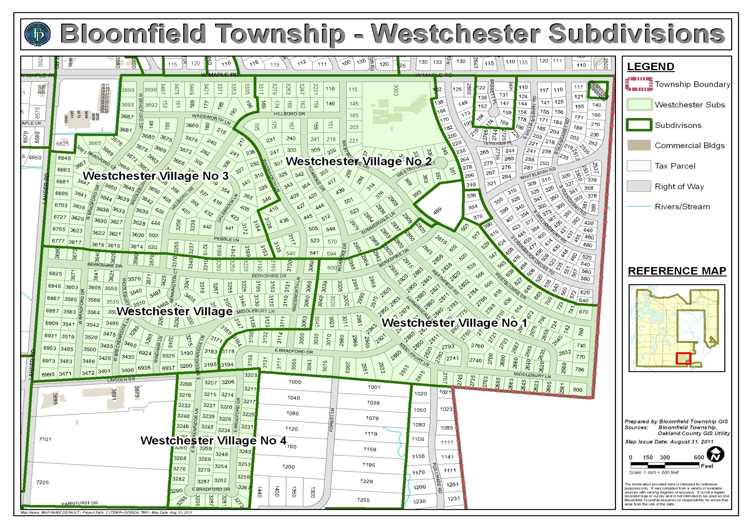
Lenox Township (this is an example-not truly Lenox Township)
E.C.F. 34112
E.C.F. 34110
E.C.F.34100
E.C.F. 34100

Slide 20
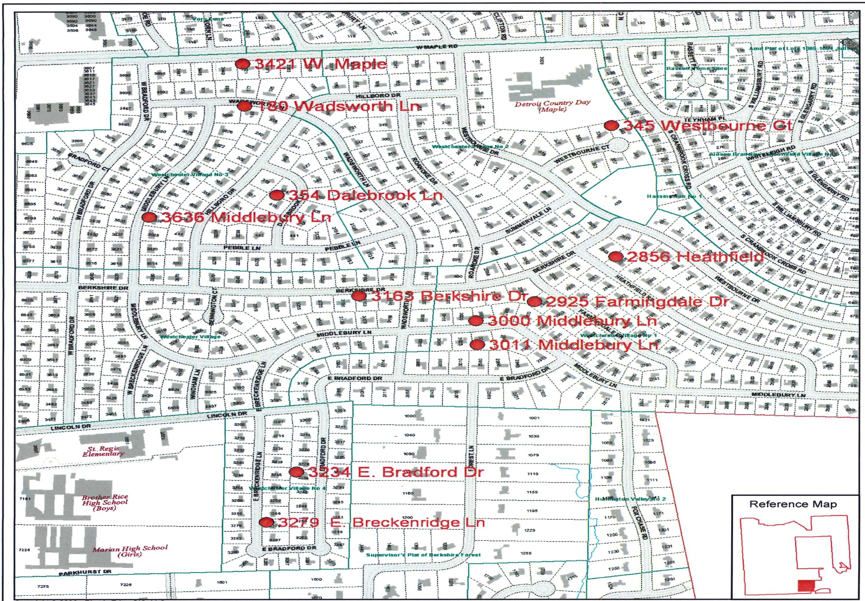
2013 Sales Study Against 2012 Values

Slide 21
2013 Sales Study Against 2012 Values
Parcel Number | Address | Sale Date | Sale Type | Nghbd | Sale Price | 2012 Assessed | Ratio
 |  |  |  |  |  | Value
19-34-103-009 | 3636 Middlebury Ln | 6/29/2012 | 1-Valid Sale | Westchester Village | $ 177,400 | 94,460 | 0.5325
19-34-103-014 | 180 Wadsworth Ln | 1/6/2011 | 1-Valid Sale | Westchester Village | $ 158,000 | 96,400 | 0.6101
19-34-126-005 | 3421 W. Maple Rd | 6/14/2011 | 1-Valid Sale | Westchester Village | $ 295,000 | 112,650 | 0.3819
19-34-127-007 | 354 Dalebrook Ln | 11/5/2010 | 1-Valid Sale | Westchester Village | $ 249,000 | 128,430 | 0.5158
19-34-177-014 | 3163 Berkshire Dr | 4/22/2011 | 1-Valid Sale | Westchester Village | $ 180,000 | 107,250 | 0.5958
19-34-201-013 | 345 Westbourne Ct | 4/25/2012 | 1-Valid Sale | Westchester Village | $ 270,000 | 117,630 | 0.4357
19-34-252-001 | 3011 Middlebury Ln | 7/28/2011 | 1-Valid Sale | Westchester Village | $ 435,000 | 208,150 | 0.4785
19-34-253-004 | 2925 Farmingdale Dr | 8/31/2012 | 1-Valid Sale | Westchester Village | $ 185,000 | 91,220 | 0.4931
19-34-253-011 | 3000 Middlebury Ln | 1/14/2011 | 1-Valid Sale | Westchester Village | $ 175,000 | 80,210 | 0.4583
19-34-254-019 | 2860 Farmingdale Dr | 4/29/2011 | 1-Valid Sale | Westchester Village | $ 249,000 | 99,430 | 0.3993
19-34-276-002 | 2856 Heathfield Rd | 6/23/2011 | 1- Valid Sale | Westchester Village | $ 200,000 | 108,660 | 0.5433
19-34-327-009 | 3279 E. Breckenridge Ln | 8/3/2012 | 1-Valid Sale | Westchester Village | $ 320,000 | 162,860 | 0.5089
19-34-327-015 | 3234 E. Bradford Dr | 12/21/2011 | 1-Valid Sale | Westchester Village | $ 360,000 | 186,220 | 0.5173
 |  |  |  |  | $ 3,076,000 | 1,499,110 | 0.4874
Target Ration 49.0% to 50.0%/48.74 = +2.52%
Sales in selected neighborhood suggests all property values in Westchester Village should receive
an average increase in value of 2.52% for 2013

Slide 22
Sales Study Creating 2013 Values
Parcel Number | Address | Sale Date | Sale Type | Nghbd | Sale Price | 2013 Assessed | Ratio
 |  |  |  |  |  | Value
19-34-103-009 | 3636 Middlebury Ln | 6/29/2012 | 1-Valid Sale | Westchester Village | $ 177,400 | 96,840 | 0.5459
19-34-103-014 | 180 Wadsworth Ln | 1/6/2011 | 1-Valid Sale | Westchester Village | $ 158,000 | 98,830 | 0.6255
19-34-126-005 | 3421 W. Maple Rd | 6/14/2011 | 1-Valid Sale | Westchester Village | $ 295,000 | 115,490 | 0.3915
19-34-127-007 | 354 Dalebrook Ln | 11/5/2010 | 1-Valid Sale | Westchester Village | $ 249,000 | 131,670 | 0.5288
19-34-177-014 | 3163 Berkshire Dr | 4/22/2011 | 1-Valid Sale | Westchester Village | $ 180,000 | 109,950 | 0.6108
19-34-201-013 | 345 Westbourne Ct | 4/25/2012 | 1-Valid Sale | Westchester Village | $ 270,000 | 120,590 | 0.4466
19-34-252-001 | 3011 Middlebury Ln | 7/28/2011 | 1-Valid Sale | Westchester Village | $ 435,000 | 213,390 | 0.4906
19-34-253-004 | 2925 Farmingdale Dr | 8/31/2012 | 1-Valid Sale | Westchester Village | $ 185,000 | 93,520 | 0.5055
19-34-253-011 | 3000 Middlebury Ln | 1/14/2011 | 1-Valid Sale | Westchester Village | $ 175,000 | 82,230 | 0.4699
19-34-254-019 | 2860 Farmingdale Dr | 4/29/2011 | 1-Valid Sale | Westchester Village | $ 249,000 | 101,940 | 0.4094
19-34-276-002 | 2856 Heathfield Rd | 6/23/2011 | 1- Valid Sale | Westchester Village | $ 200,000 | 111,400 | 0.5570
19-34-327-009 | 3279 E. Breckenridge Ln | 8/3/2012 | 1-Valid Sale | Westchester Village | $ 320,000 | 166,960 | 0.5218
19-34-327-015 | 3234 E. Bradford Dr | 12/21/2011 | 1-Valid Sale | Westchester Village | $ 360,000 | 190,910 | 0.5303
 |  |  |  |  | $ 3,253,400 | 1,633,720 | 0.5022
The average assessment change was applied to the neighborhood as a whole.

Slide 23
How Assessments Are NOT FORMULATED
How Assessments Are NOT Formulated
Parcel Number | Sale Date | Sale Type | Nghbd | Sale Price | 2012 Assessed | Ratio | 2013 Assessed | % Change
 |  |  |  |  | Value |  | Value
19-34-103-009 | 6/29/2012 | 1-Valid Sale | Westchester Village | $ 177,400 | 94,460 | 0.5325 | 88,700 | (0.0610)
19-34-103-014 | 1/6/2011 | 1-Valid Sale | Westchester Village | $ 158,000 | 96,400 | 0.6101 | 79,000 | (0.1805)
19-34-126-005 | 6/14/2011 | 1-Valid Sale | Westchester Village | $ 295,000 | 112,650 | 0.3819 | 147,500 | 0.3094
19-34-127-007 | 11/5/2010 | 1-Valid Sale | Westchester Village | $ 249,000 | 128,430 | 0.5158 | 124,500 | (0.0306)
19-34-177-014 | 4/22/2011 | 1-Valid Sale | Westchester Village | $ 180,000 | 107,250 | 0.5958 | 90,000 | (0.1608)
19-34-201-013 | 4/25/2012 | 1-Valid Sale | Westchester Village | $ 270,000 | 117,630 | 0.4357 | 135,000 | 0.1477
19-34-252-001 | 7/28/2011 | 1-Valid Sale | Westchester Village | $ 435,000 | 208,150 | 0.4785 | 217,500 | 0.0449
19-34-253-004 | 8/31/2012 | 1-Valid Sale | Westchester Village | $ 185,000 | 91,220 | 0.4931 | 92,500 | 0.0140
19-34-253-011 | 1/14/2011 | 1-Valid Sale | Westchester Village | $ 175,000 | 80,210 | 0.4583 | 87,500 | 0.0909
19-34-254-019 | 4/29/2011 | 1-Valid Sale | Westchester Village | $ 249,000 | 99,430 | 0.3993 | 124,500 | 0.2521
19-34-276-002 | 6/23/2011 | 1- Valid Sale | Westchester Village | $ 200,000 | 108,660 | 0.5433 | 100,000 | (0.0797)
19-34-327-009 | 8/3/2012 | 1-Valid Sale | Westchester Village | $ 320,000 | 162,860 | 0.5089 | 160,000 | (0.0176)
19-34-327-015 | 12/21/2011 | 1-Valid Sale | Westchester Village | $ 360,000 | 186,220 | 0.5173 | 180,000 | (0.0334)
 |  |  |  | $ 3,253,400 | 1,593,570 | 0.4898 | 1,626,700 | 0.0208
Assessors are responsible for valuing ALL properties in the neighborhood, not just the sold properties.

Slide 24
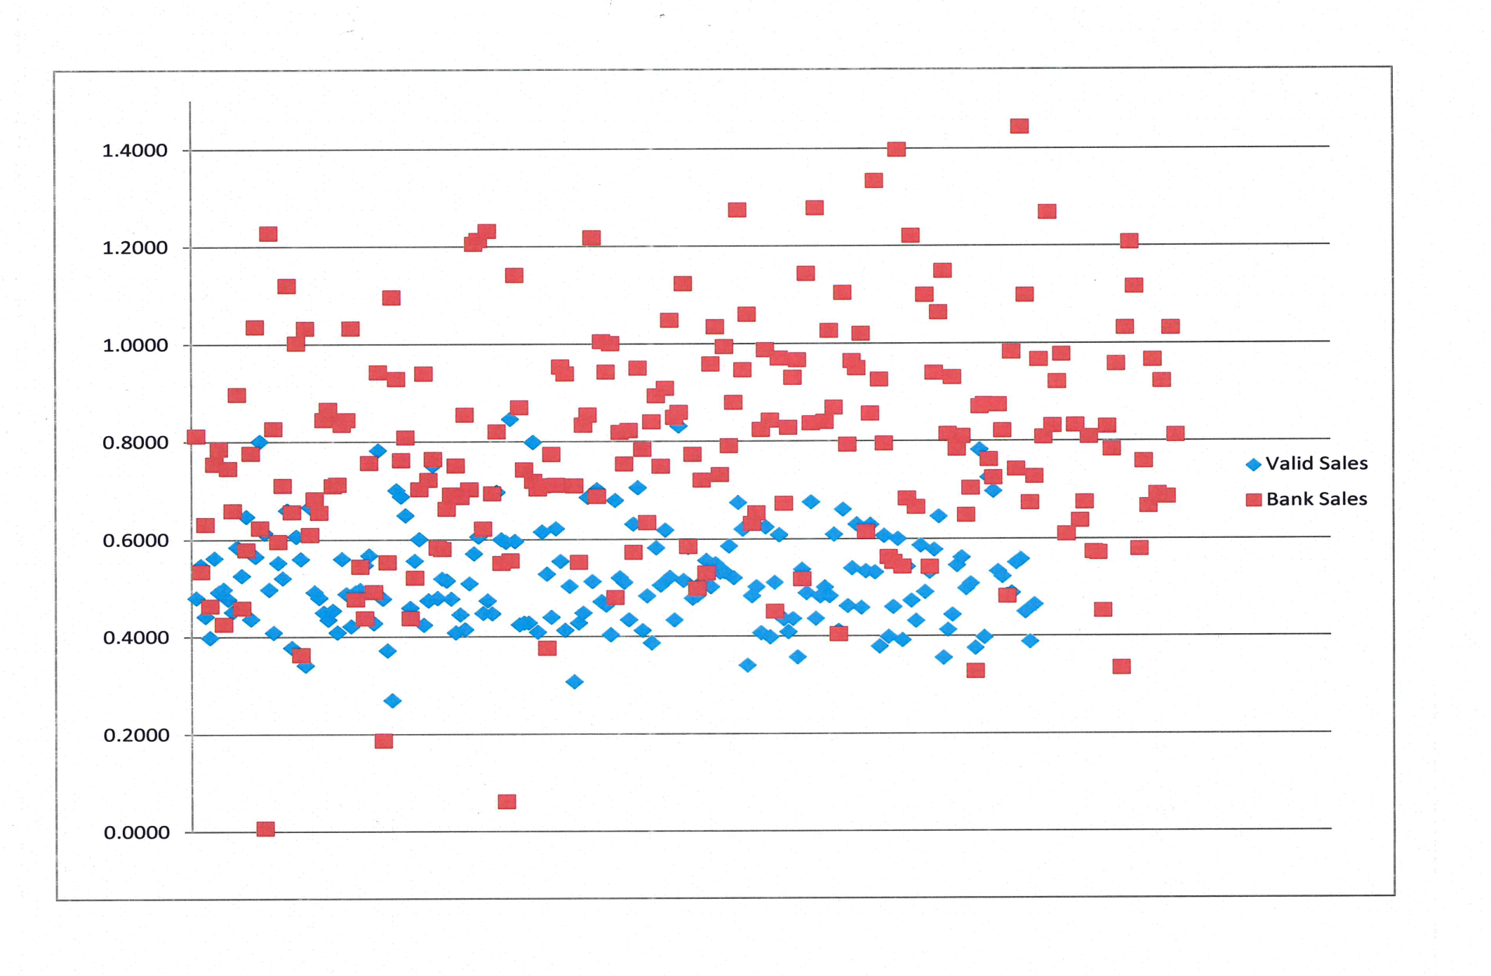
Sheriff vs Foreclosure Sales
2010

Slide 25
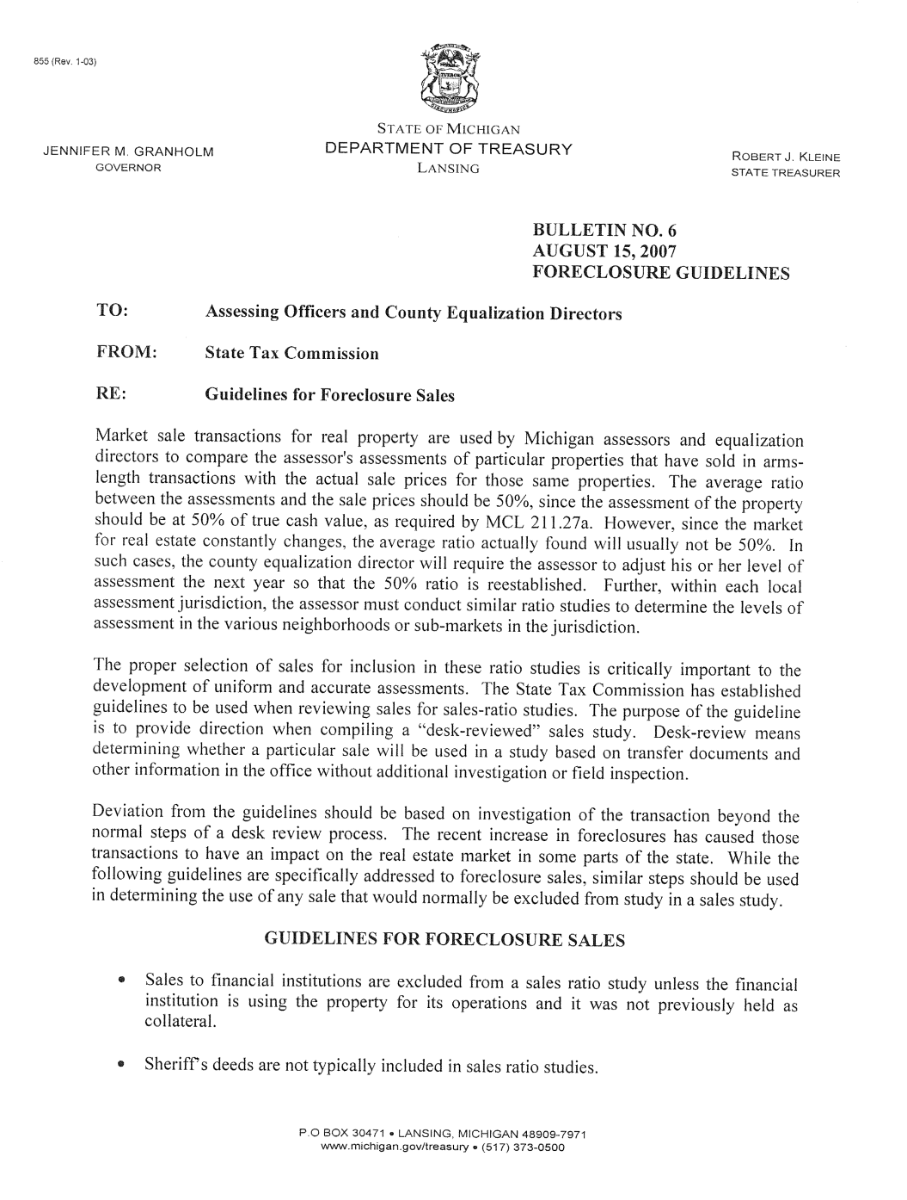
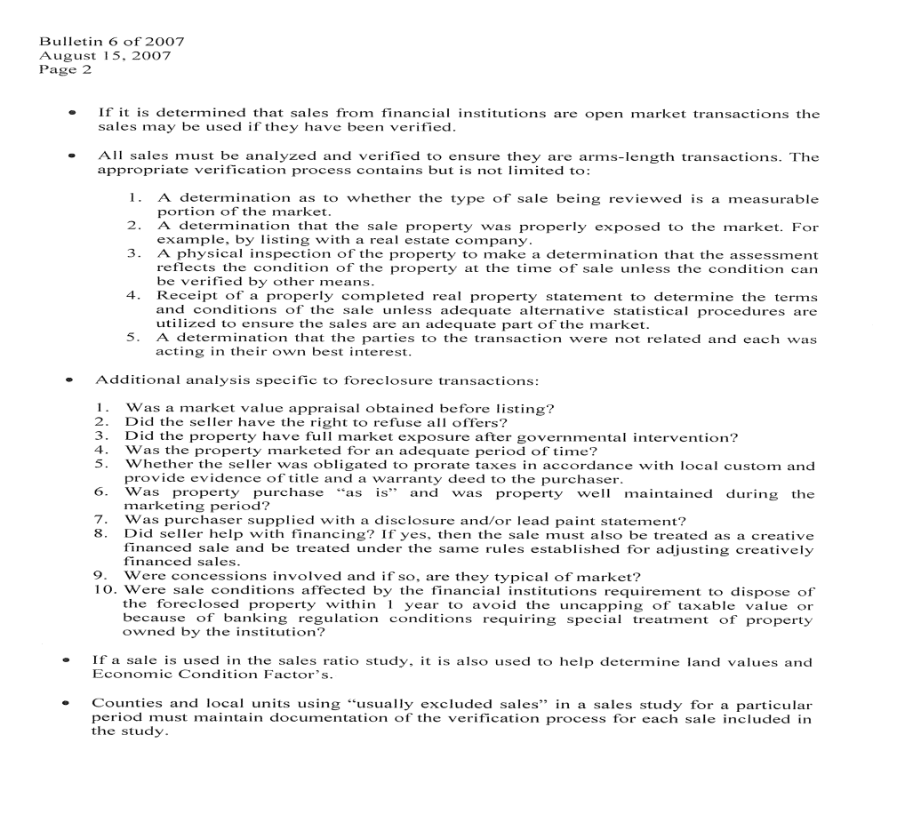
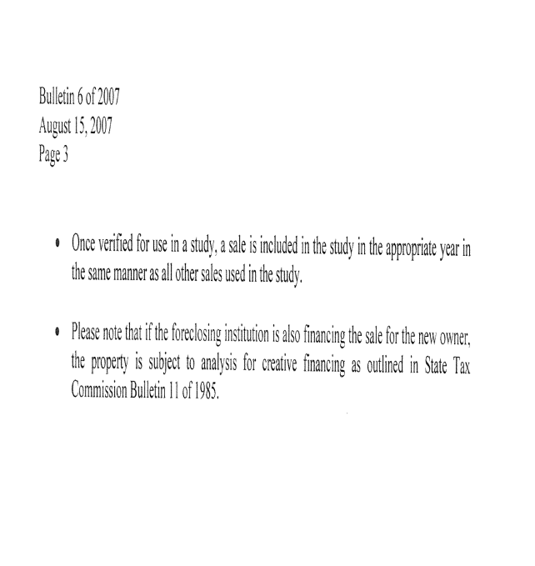
Guidelines for Foreclosure Sales
Bulletin No. 6
August 15, 2007

Slide 26

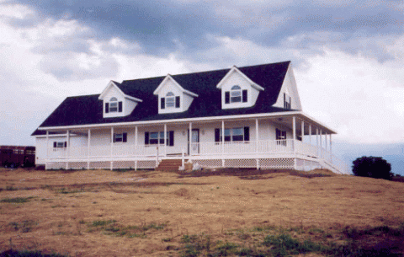
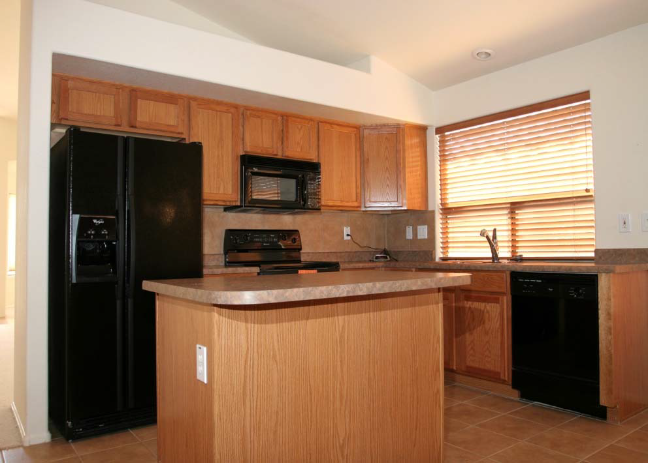
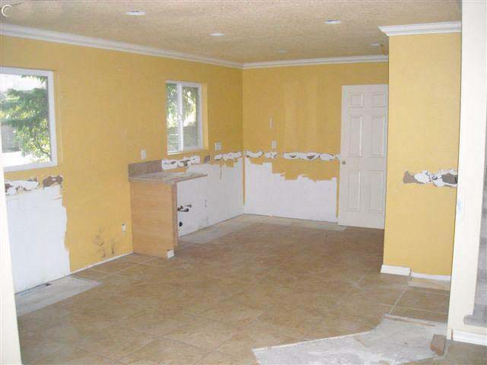

Slide 27
Boards of Review
---------------------------------------------------------------------------------------------------------
Meets 3 times a year. March, July & December.
Valuation Appeals can only be heard in March.
July and December Boards are for Clerical corrections and Administrative changes.
Many communities address poverty appeals in July and December. Reasons: 1) Tax returns are filed in April. 2) Less hectic schedule allows more time for boards to review poverty applications.

Slide 28
Boards of Review
---------------------------------------------------------------------------------------------------------
Who can be a member of a Board of Review?
Three, six, or nine electors of the Township shall be appointed by the Township to serve as the Board of Review. If 6 or 9 are appointed, they are divided into Boards of 3 individuals for the purpose of hearing and deciding. The size, composition, and manner of appointment of the Board of Review of a Township may be prescribed by Township Charter or Ordinance and a City may be prescribed by City Charter.
Do Board of Review Members have to be property owners?
At least 2/3 of the members shall be property taxpayers of the Township.

Slide 29
How to Prepare for the Board of Review?
The taxpayer must provide evidence showing the assessment placed upon the property is incorrect. The Board of Review needs good reason to alter an assessment. It is imperative to be able to answer the questions, “What do you think the property is worth?” and “What are you basing your opinion on?”
All assessments are to be based on the sales of similar properties. You may hire a professional appraiser, or you can look at sales in your neighborhood and compare them to your home. Per state law, the sale price of a property cannot be the sole determining factor of the assessment of that property. Neither the Assessor nor the Board of Review can raise or lower a property assessment based solely on its sale price. Mortgage appraisals also may not show True Cash Value.
State Equalized Value = True Cash Value X 50%

Slide 30
Where to find sales data?
Lenox Township Assessor’s Office
Realtors
MLS
Register of Deeds
Websites (Sales must be verified)

Slide 31
Township Website
www.lenoxtwp.org
Click on “Departments” then “Assessing”
Homeowner can look at their own property free.
Cost associated for searching for other properties.

Slide 32
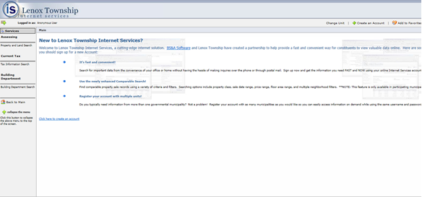
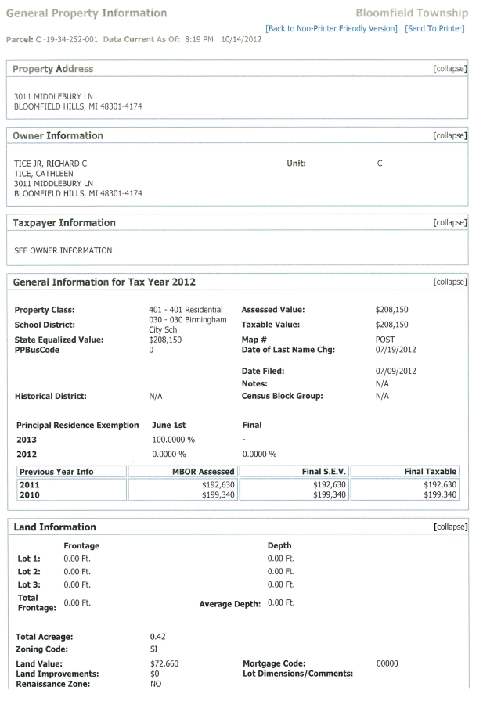
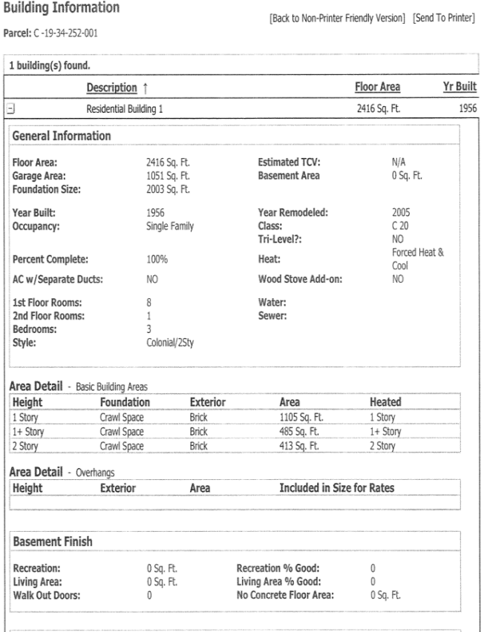
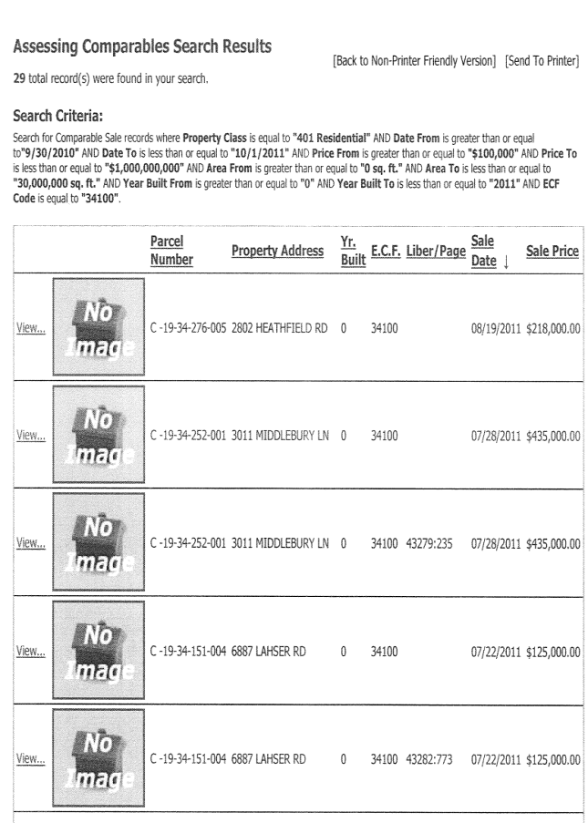
www.lenoxtwp.org

Slide 33
Example
Sales Comparable
Approach

Slide 34
Final Preparation for MBOR
Validate all data.
Make the presentation concise.
Time with BOR may be limited, get straight to the point.
More Data isn’t always better.

Slide 35
Hardship
What is a Hardship?
Section 211.7u of the Michigan General Property Tax Act defines the poverty or Poverty Exemption as a method to provide relief for those who, in the judgment of the Board of Review, are unable to fully contribute to the annual property tax burden of their principal residence due to their financial status.

Slide 36
Hardship
How do I apply for a Hardship?
The hardship waiver must be filed and approved by your local Board of Review on a yearly basis. Contact the assessing office for an application. (July Boards for some communities)
Hardship Guidelines are established by the Township. The guidelines include an asset test and income test.

Slide 37
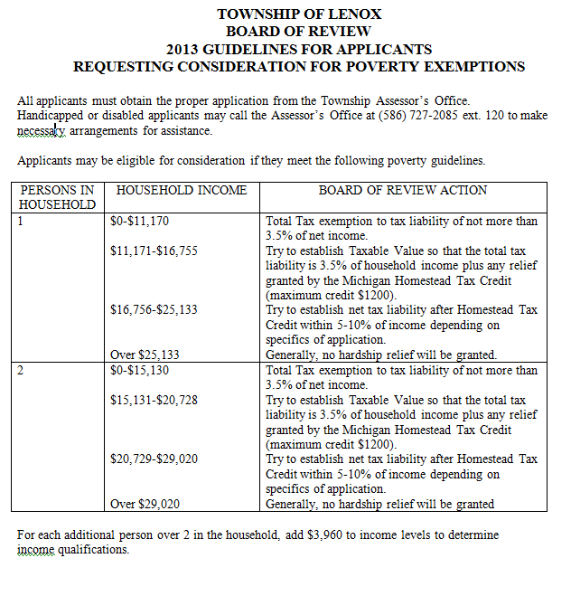
Poverty Guidelines

Slide 38
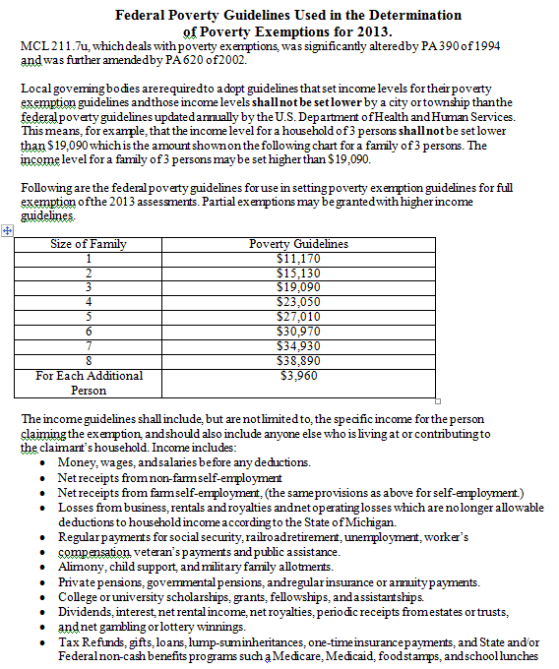
Poverty Guidelines

Slide 39
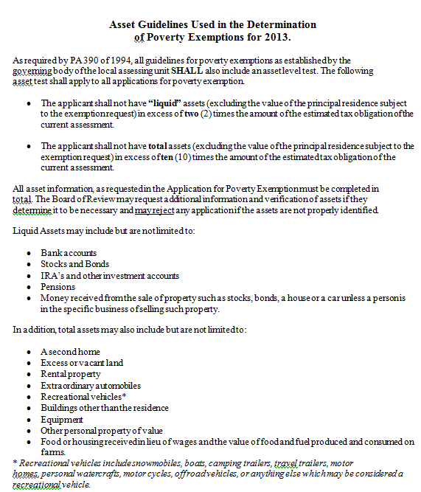
Poverty Guidelines

Slide 40
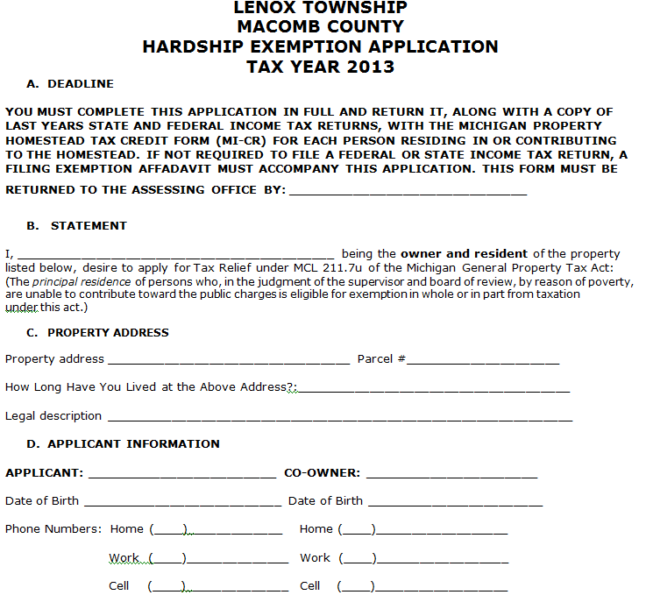
Poverty Application

Slide 41
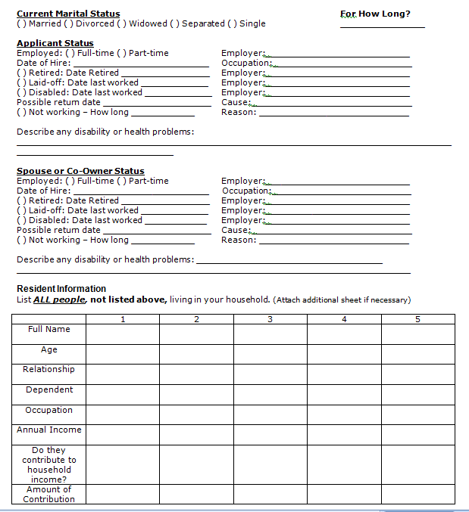
Poverty Application

Slide 42
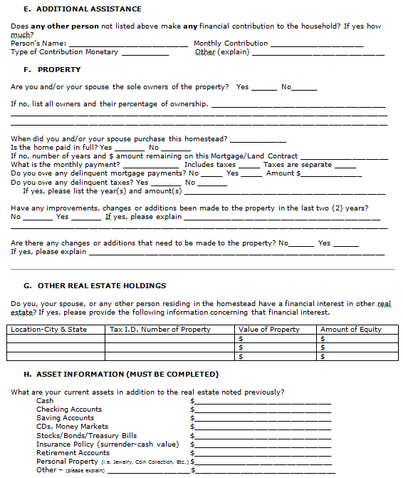
Poverty Application

Slide 43
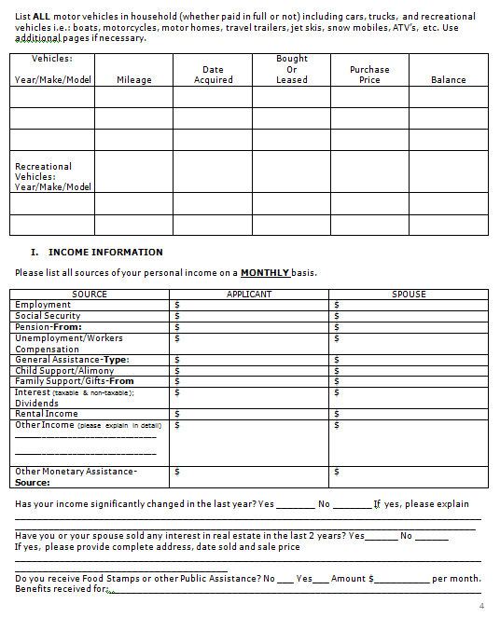
Poverty Application

Slide 44
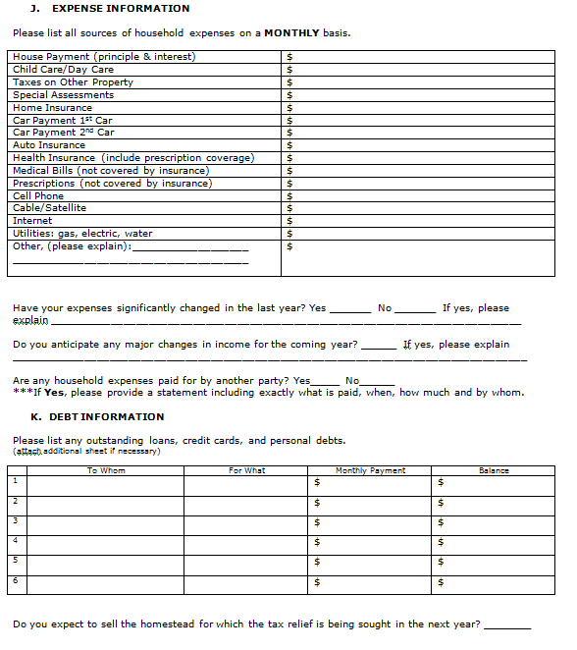
Poverty Application

Slide 45
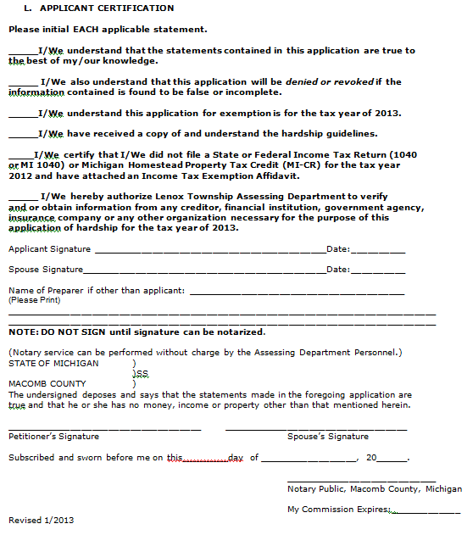
Poverty Application

Slide 46

The Outcomes of the MBOR
Letters will be mailed to property owners after the closing of March Board of Review.
Statutory Law: These letters are to be delivered to the property owners no later than June 3rd. (first Monday in June)
- No Change
- Lowering of Assessment
- Lowering of Taxable Value
- Raising of Assessment
The letter mailed to property will contain instructions on appealing to the Michigan Tax Tribunal.

Slide 47
MTT for Home Owners
-Small Claims-
What is the Michigan Tax Tribunal?
Quasi-Judicial agency to preside over valuation disputes.
How does the Tribunal Work?
Informal hearing with administrative law judge. You must appeal to the MBR to appeal to the Tax Tribunal.
Where do I file my appeal?
Michigan Tax Tribunal
P.O. Box 30232
Lansing, MI 48909
Ph: (517) 636-7550
Fax: (517) 636-7580
When do I File?
Appeals must be filed to the Tribunal by July 31st (residential properties).
How do I file?
By writing a letter to the Tribunal.
What are the Fees?
None for primary residences.

Slide 48
Questions

